Slide 1
StatCast Analytics: Predicting Batted Ball Distance
Using Multi-Linear Regression to Quantify Hitting Performance
Fernando Guzman

Slide 2

Problem: Quantifying the Mechanics of Power
In modern baseball, teams seek to understand which mechanical inputs, such as swing path, directly correlate with power output. The specific challenge is to quantify the marginal impact of a player’s Exit Velocity (EV) and Launch Angle (LA) on the most fundamental measure of power, distance, or more specifically, batted ball distance.

Slide 3
Significance
Player Evaluation: Provides objective metrics for evaluating player development and trade value.
Coaching & Training: Pinpoints the precise changes (e.g., higher EV vs. optimal LA) that lead to performance gains.
Scouting: Creates a statistical baseline for future player projection.

Slide 4
Solution: Multi-Linear Regression
I propose using a Multi-Linear Regression model to quantify the linear relationship between several hitting metrics and the average distance a player hits the ball.
ML Technique: Regression
  Goal: Predict a continuous numerical value (Average Distance).
  Justification: Linear Regression is the most effective tool to show the correlation and marginal contribution of independent variables (EV, LA) to the dependent variable (Distance). The resulting coefficients are highly interpretable, directly supporting the project's goal of quantification.
  Model: Scikit-learn’s LinearRegression (implemented in prototype)

Slide 5
Data Description: Aggregated StatCast Data
Key Features (Independent Variables – X)
Feature Name | Type | Role
ev_avg | Numeric | Primary predictor (speed of ball off bat)
la_avg | Numeric | Primary predictor (angle of ball off bat)
barrels_batted_balls_percentage | Numeric | Proxy for optimal contact quality
hard_hit_percentage | Numeric | Control for overall high-velocity contact
The prototype uses MLB StatCast data aggregated at the player-season level, filtered to players with sufficient Batted Ball Events (BBE>100).
Target variable: dist_avg, the average distance (in feet) of all batted balls hit by the player in that season.

Slide 6
Model Workflow
Data Preprocessing
Model Training & Evaluation
Loading: Load mlb-batter-exit-velocity.csv.
Cleaning: Rename columns to ev_avg, la_avg, dist_avg.
Missing Data: Impute numerical NaNs using the mean.
Filtering: Remove players with low Batted Ball Events to ensure statistical validity.
Split: 80% Training, 20% Testing (random_state=42).
Train: Fit the Linear Regression model.
Metrics:
  R-squared (R²): Measures the proportion of the variance in Average Distance that is predictable from the input features (Success Metric: > 0.70).
  Root Mean Squared Error (RMSE): Measures the average magnitude of the prediction error (Success Metric: Keep error under 5 feet).

Slide 7
Deployment Scenario: Integrated Scouting Tool
Data Pipeline: Integrate model input with real-time StatCast data feeds.
Model API: Deploy the trained LinearRegression model as a REST API (e.g., using Flask or FastAPI).
User Interface: A simple web application allowing coaches/analysts to input a player's average EV and LA and receive an immediate prediction of their average batted ball distance.
Continuous Monitoring: Retrain the model annually with new season data to ensure performance remains accurate as league-wide hitting trends evolve.
XAI Integration: Display the model's coefficients alongside the prediction, so users understand why the prediction was made.

Slide 8
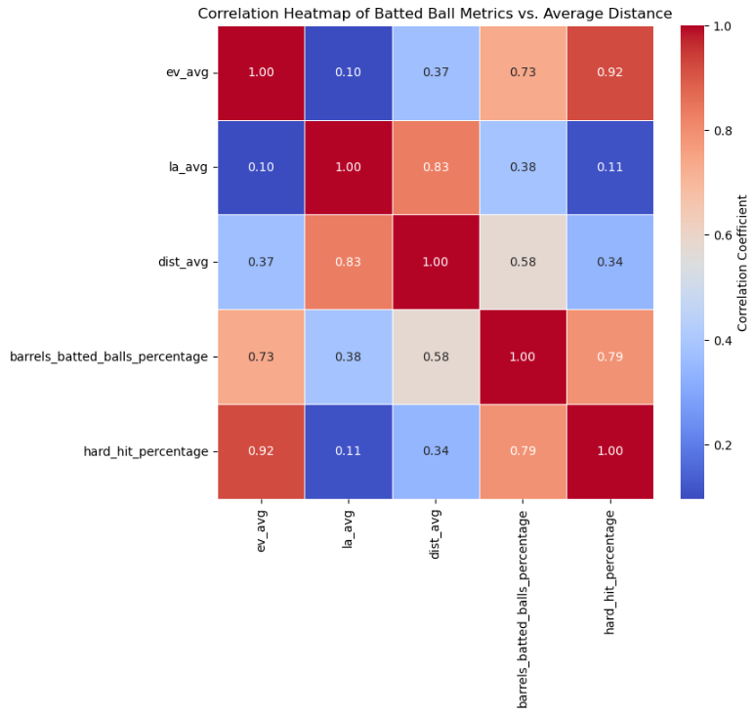
Multi-Linear Regression Performance Summary
R²=0.7892
RMSE= 9.5295 feet
Correlation Heatmap Insight
The heatmap shows a strong positive correlation of 0.83 between la_avg and the target dist_avg.
Exit Velocity (ev_avg) shows a moderate positive correlation of 0.37, indicating that Launch Angle is the dominant factor in simple correlation to average distance within this aggregated dataset.

Slide 9
Ethical Considerations
Fairness and Bias in Player Evaluation
Challenge
Mitigation (XAI)
Over-reliance on the model's metrics (EV/LA) can lead to bias against specific hitting styles. For example, contact hitters or players who optimize for line drives may be undervalued if the system solely rewards maximizing distance.
Transparency: Use the model's coefficients (Section 9) to transparently show the marginal impact of each variable.
Holistic View: Treat the model as a predictive input, not a final evaluation. Analysts must combine the model's quantified correlation with traditional scouting data.
Monitoring: Regularly test the model for disparate impact across groups (e.g., high-contact vs. high-power hitters) to ensure evaluation is fair.

Slide 10
XAI: Model Interpretation
Feature Coefficients
(Marginal Impact)
Feature | Coefficient | Interpretation
ev_avg | 3.32 | +3.32 feet in distance for every 1 mph increase in average EV.
la_avg | 3.22 | +3.22 feet in distance for every one-degree increase in average LA.
barrels_batted_balls_percentage | 1.12 | +1.12 feet in distance for every 1% increase in Barrel rate.
hard_hit_percentage | -0.66 | -0.66 feet in distance for every 1% increase in Hard-Hit rate.
The regression coefficients quantify the “correlation” by showing the marginal change in average distance (in feet) associated with a one-unit increase in the feature, holding all other features constant. From the la_avg and ev_avg, we can infer that launch angle has a nearly equal marginal impact as exit velocity. The hard-hit percentage suggests that, when accounting for the optimal Barrel rate, simply increasing the overall hard-hit rate without quality contact is slightly detrimental to average distance.

Slide 11

Reflection & Next Steps
In my initial plan that I spoke about in my discussion post, I wanted to predict home run count using a complex gradient boosting regressor (XGBoost). It wasn’t until after reviewing my data, that I realized the aggregated data was not suitable for complex classification or count prediction. This pivot highlighted a key ML lesson: data constraints dictate the appropriate model. From this, I was able to pivot to a multi-linear regression model to predict a continuous distanced-based metric.
In my next steps to making the machine learning model I want, I need to source pitch-by-pitch data to build my XGBoost classification model to predict the likelihood of a single ball being a home run.

